Slide 1
Attrition Analysis
-By Yash SARGAR

Slide 2
Introduction
This project seeks to understand and mitigate employee attrition by analyzing various factors influencing departure rates within our company. Leveraging Tableau for data visualization, we scrutinized diverse datasets to uncover meaningful insights. Our findings aim to provide actionable strategies to reduce attrition and foster a more stable and engaged workforce.
Tools We used-
Employing Tableau as our primary analytical tool, we meticulously examined disparate datasets to discern patterns, correlations, and trends. Our visualization efforts have not only rendered the data more comprehensible but have also facilitated the identification of critical indicators for attrition.

Slide 3
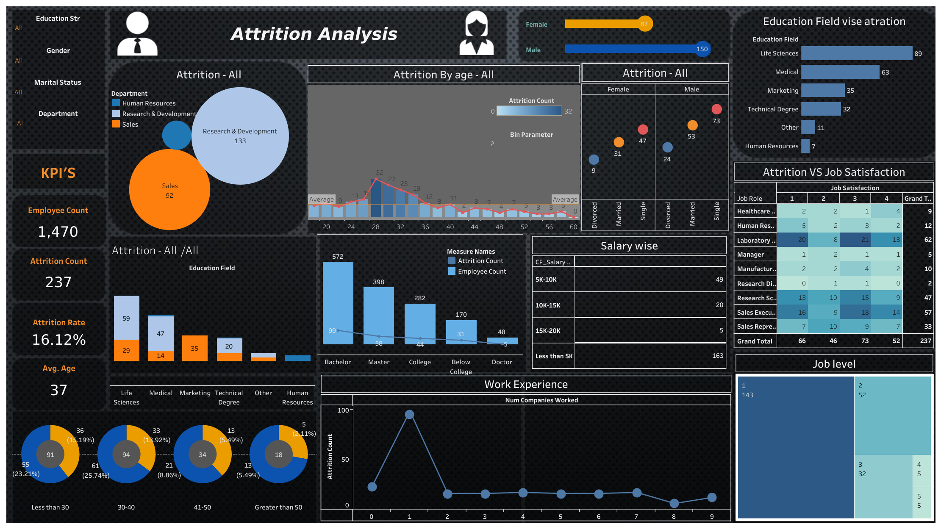

Slide 4
Insights
KPI’s
Attrition Rate is 16.12%
Age average is 37 also Male attrition is grater than Female.
Age
In second graph we see the above average count is in between 25 – 35 age.
In below pie chart
Less than 30 (Male =55 and Female=36)
30 – 40 (Male =61 and Female =33)

Slide 5
Education Field
Life science field has more attrition and in that RND department have at most attractions.
Gender and Marital status
The single male and female has attrition.
Education and Salary
Bachelor degree have more and Doctor degree have less attrition.
As salary increases attrition is decrease.
Also same with job level.
Job Satisfaction and Work Experience
50% of attraction happening in 3 job role with respect to satisfaction.
Those who have 1 previous experience the percentage of attritions is 40-50%.

Slide 6
Conclusion
Attrition is notably higher in the Life Science field, particularly within the R&D department.
Single individuals, both male and female, exhibit higher attrition rates.
Employees with Bachelor's degrees are more prone to attrition compared to those with Doctorates. However, as salary and job level increase, attrition tends to decrease.
Job satisfaction significantly influences attrition, with around 50% of attrition occurring in three specific job roles.
Employees with only one previous work experience show a higher attrition rate, ranging from 40-50%.
The overall attrition rate stands at 16.12%, with a greater proportion among males compared to females. Additionally, the average age of employees experiencing attrition is 37, with a concentration between 25-35 years old.

